Slide 1
Languages and Disciplines in the 21st century: Interdisciplinarity and Italian Studies
Dr Giuliana Pieri
Royal Holloway University of London
http://interdisciplinaryitaly.com/

Slide 2
http://interdisciplinaryitaly.com/
AHRC funded research network
Interdisciplinary Italy 1900-2015: Art, Music, Text
Dr Clodagh Brook (Birmingham University)
Dr Giuliana Pieri (Royal Holloway University of London)

Slide 3
www.italydatabase.com

Slide 4
1. Interdisciplinarity and the existing Disciplines

Slide 5
2. Teaching Italian Studies

Slide 6
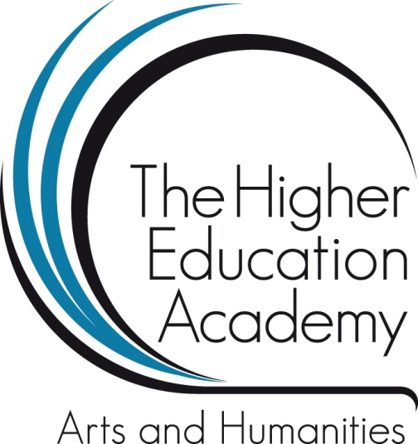
TEACHING ITALIAN STUDIES IN THE 21ST CENTURY: TRENDS AND CHALLENGES London, 15 March 2013
Higher Education Academy
Discipline Workshop and Seminar Series 2012-13

Slide 7
Aims
To highlight the role of content in the curriculum
To counterbalance previous reports with their exclusive focus on language provisions
To open up a discussion within our discipline on the current and future shape of Italian Studies

Slide 8
Previous reports
2012-13 UCLM/AULC: survey of IWLP activity in universities in the UK
February 2013: British Academy: http://www.britishcouncil.org/organisation/publications/languages-future
2013 British Council: http://www.britishcouncil.org/organisation/publications/languages-future

Slide 9
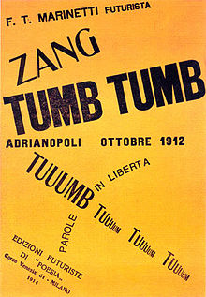
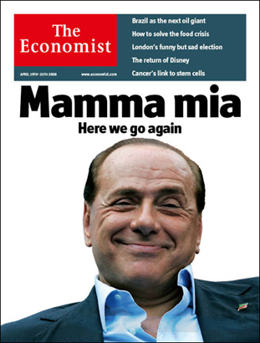
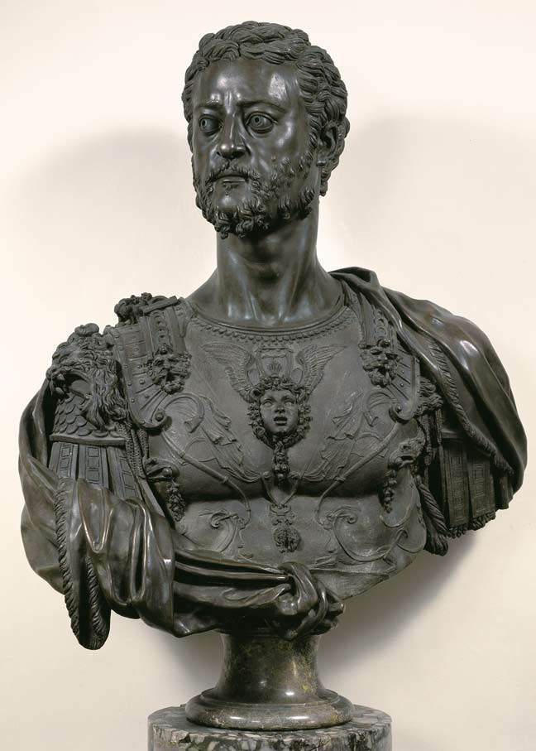
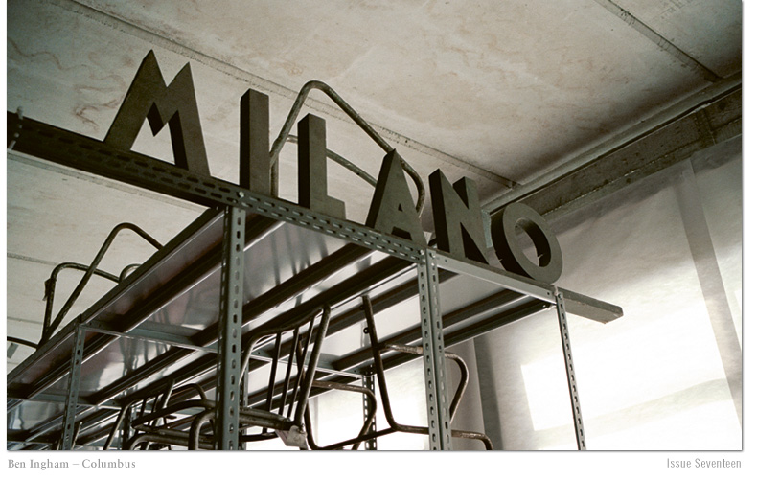
Teaching Italian Studies in the 21st century

Slide 10
Revised Categories
Medieval Literature, Renaissance Literature, Renaissance Art, and Dante (with the option of separating Dante)
17th and 18th Century Culture, and 19th Century Literature
Cinema
20th and 21st century literature
Fascism and Italian Nationalism (a broad category renamed Italian History)
Translation and Linguistics
Other (includes also Fashion and Opera Culture)
Language courses were not included.

Slide 11
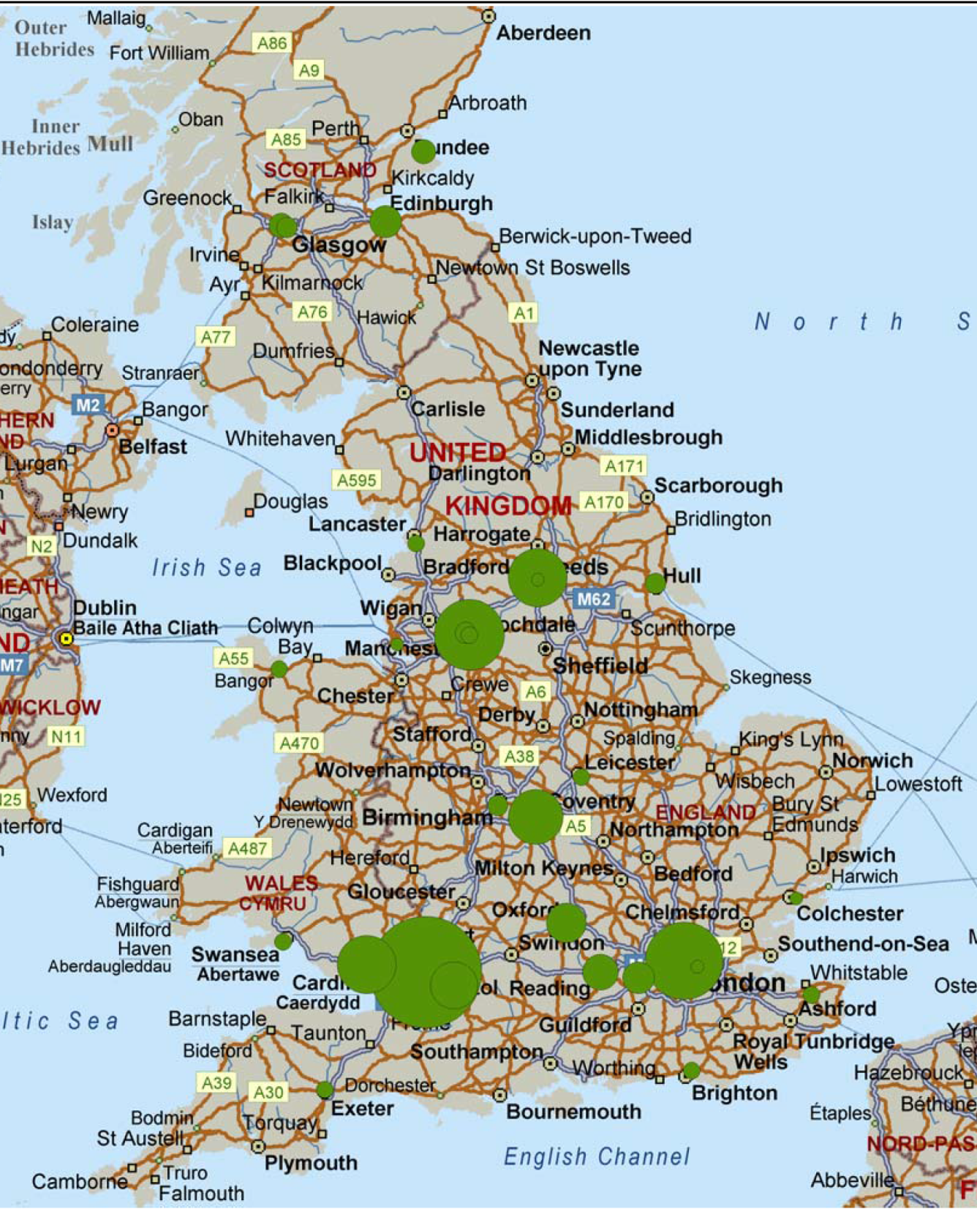

Slide 13
Module categories by year

Slide 18
3. The Research Context

Slide 19
1. A quest to grasp totality

Slide 20
2. Radical Postmodern Dissent

Slide 21
“Interdisciplinary work is not a peaceful operation: it begins effectively when the solidarity of the old disciplines breaks down, a process made more violent, perhaps, by the jolts of fashion to the benefit of a new object and a new language, neither of which is the domain of those branches of knowledge that one calmly sought to confront.”
Roland Barthes, ‘From Work to Text’ in Textual Strategies, 1979

Slide 22
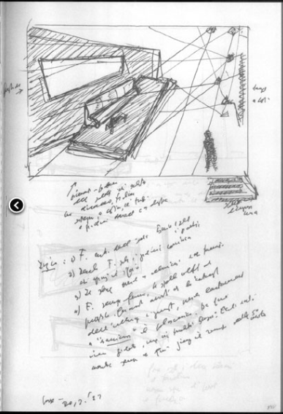
3. Hybrid Objects of Study

Slide 24
1960s

Slide 25
ITALIAN STUDIES
1935-1960
Of 102 articles:
61 literary, cultural, textual histories
29 literary connections between Italy and UK
1 contemporary literature
2 linguistics
9 art history
1 music

Slide 26
ITALIAN STUDIES
1935-1960
ITALIAN STUDIES
2013
Of 102 articles:
61 literary, cultural, textual histories
29 literary connections between Italy and UK
1 contemporary literature
2 linguistics
9 art history
1 music
Of 20 articles:
13 literature and 1 on book production
3 written historical, philosophical/theological works.
1 linguistics
4 cinema
1 magazines

Slide 27
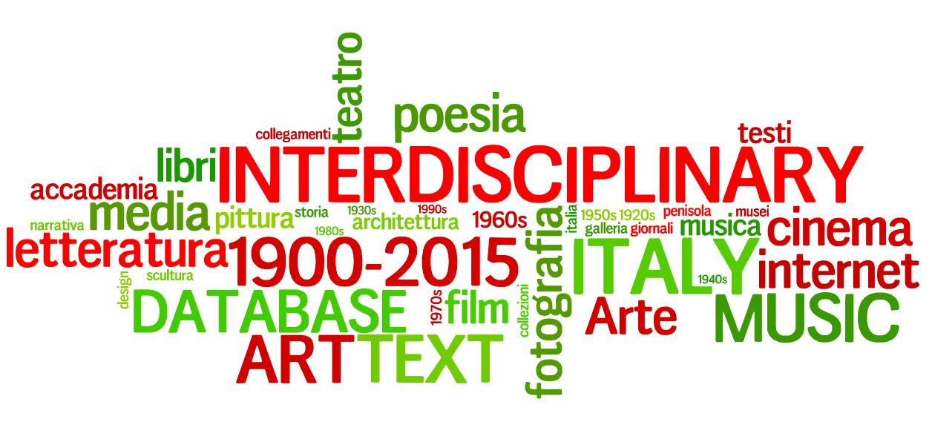
Thank you!

